Slide 1
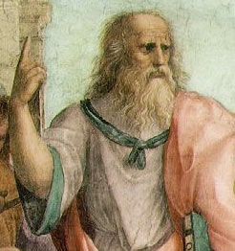
eIDEAS Usability Questionnaires Feedback
Presented by: Weekend Warriors
Malkiat Singh
Mohamed Ali
M. Salim Bakri

Slide 2
Contents
Demographic Information
Demographic Stat Graphs
Guided Questions
Usability Graphs
Open Ended Questions
Suggested Modifications

Slide 3

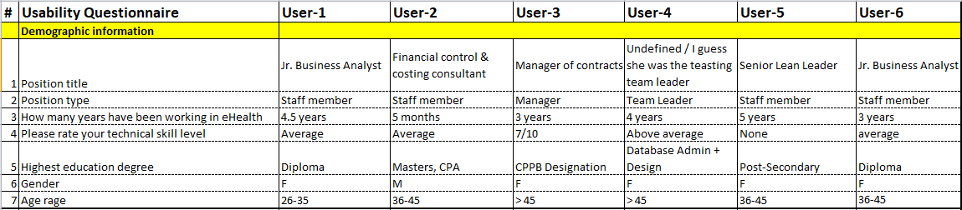
Demographic information

Slide 4
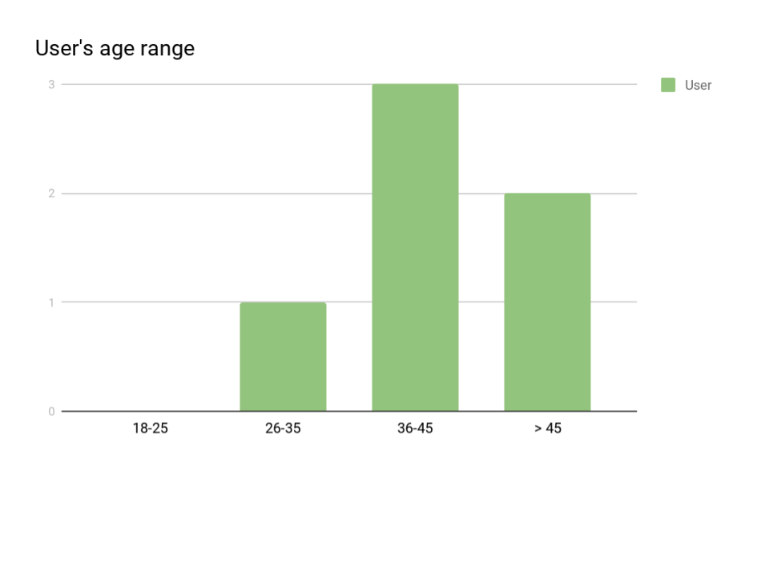
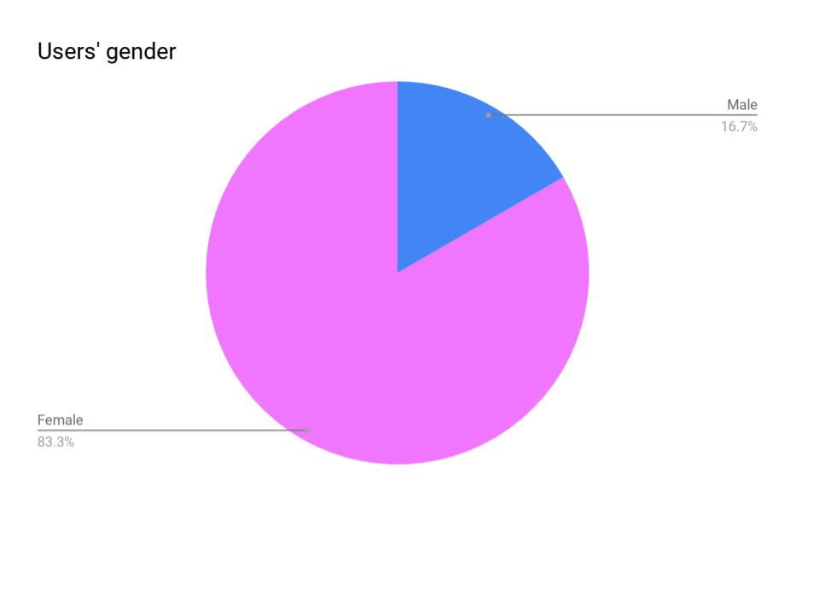
Demographic Statistical Graphs

Slide 5
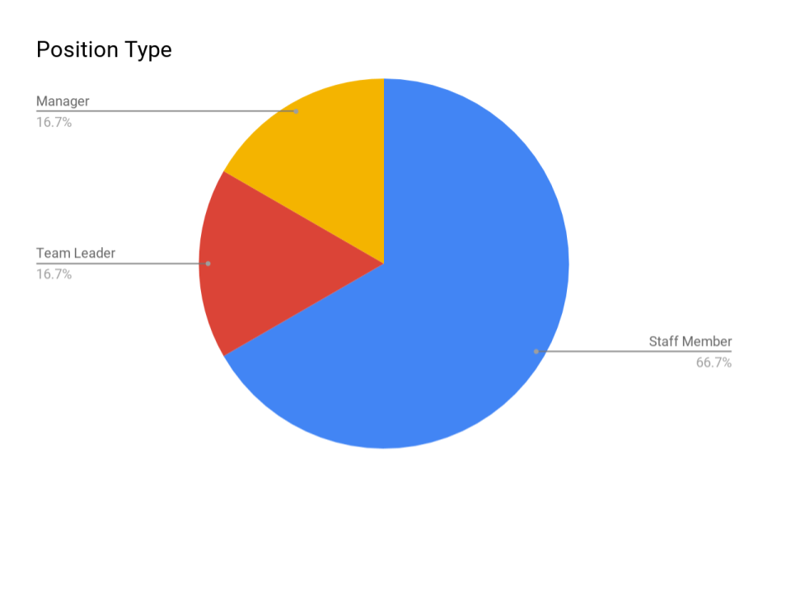
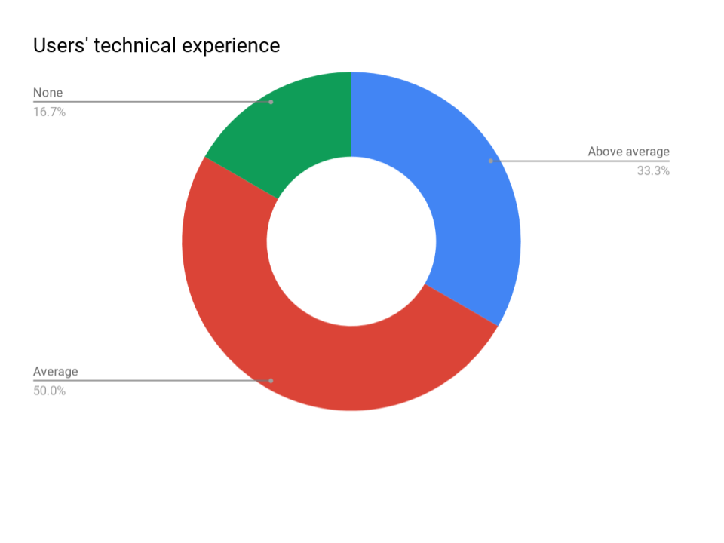
Demographic Statistical Graphs

Slide 6
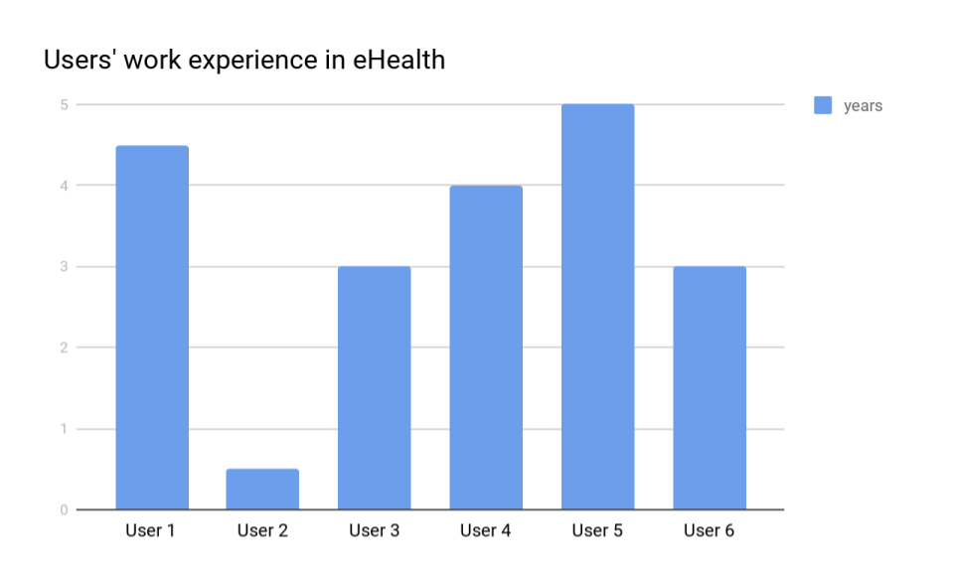
Demographic Statistical Graphs

Slide 7
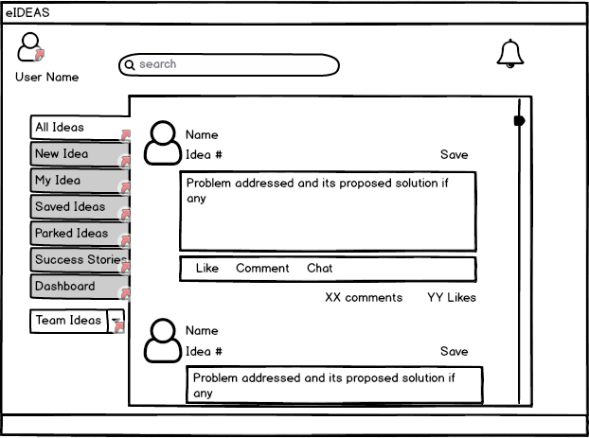
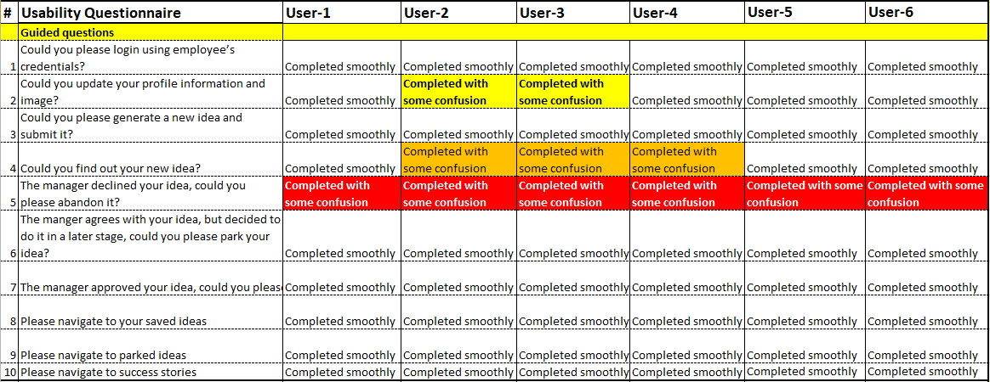
Guided Questions

Slide 8
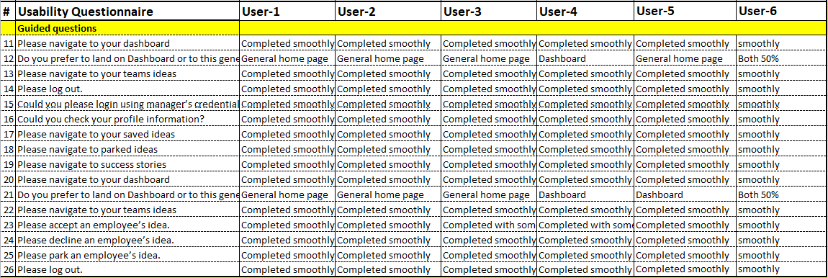
Guided Questions

Slide 9
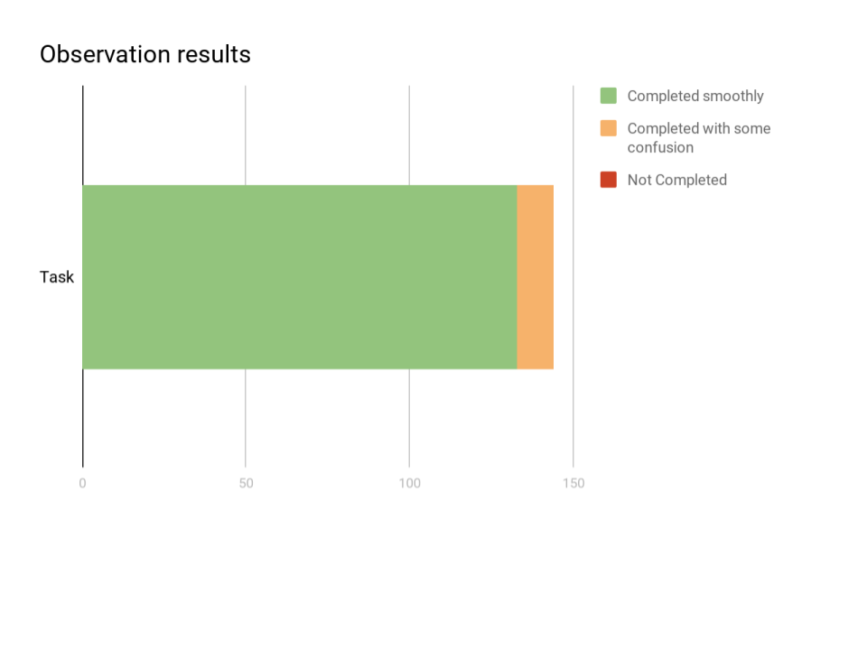
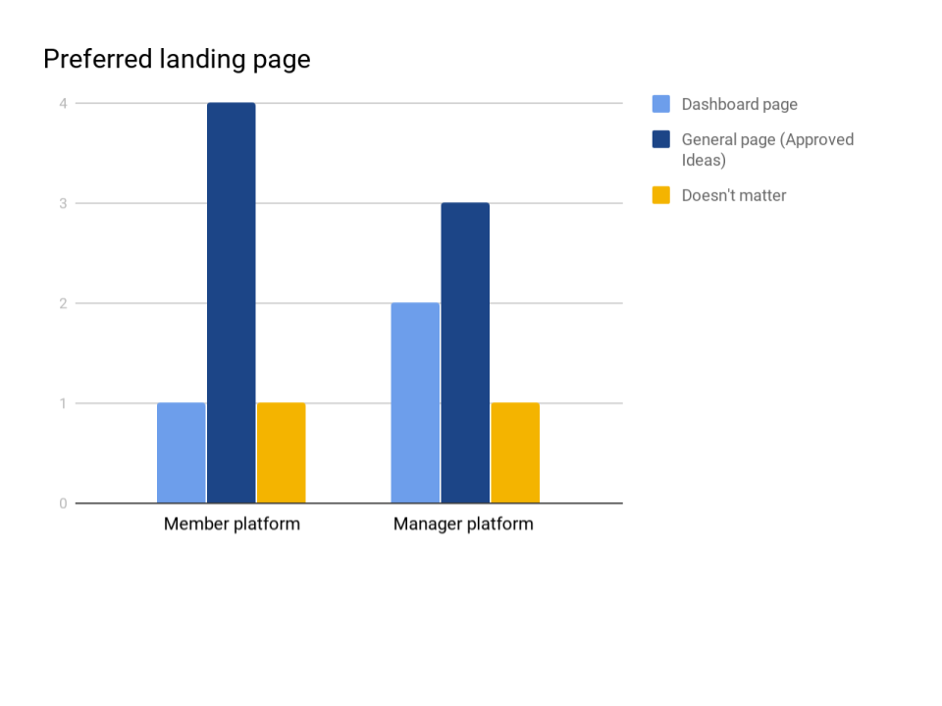
Usability Statistical Graphs

Slide 10
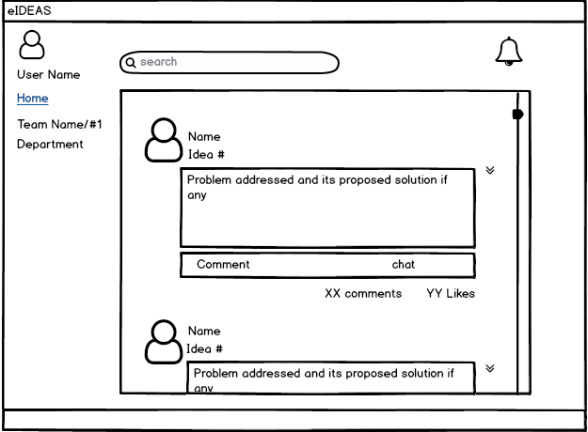
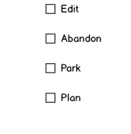

Guided Questions-Issues raised
How to abandon
An idea?
Can’t find three dot menu from first glance without guidance.

Slide 11
Guided Questions-Issues raised
Where can I find out my submitted idea?
Found some difficulty to relate My Idea tab with the submitted idea

Slide 12
Guided Questions Feedback
How do I update my profile?
Found some difficulty to predict the icon.

Slide 13
What did you like and didn't like about eIDEAS?
DID LIKE:
The User experience (Simple and easy to use)
Digested emails are very helpful
Likes mechanism, reordering ideas based on likes counter, is useful for identifying the best ideas.
Ideas are organized by teams and shown based on each user privilege.
DID NOT LIKE:
DO phase current implementation.
Idea’s ID label on each idea.

Slide 14
Weekend Warriors Suggested modifications
After analyzing the comments and feedbacks that were collected from the usability questionnaires, we suggest the following:
Modify drop down menus and pop-up menus to be more realistic.
Modify the “Arrows Button” to be an “Action Button” for more clear view.
Remove “idea's ID” since end-users don’t care about this information.
Keep the landing page as it is but change the tab’s label to be “Approved Ideas”.
Change idea’s labels from text to icons e.g. (like, comment, chat).
Change “Abandon” labels to be “Declined”.

Slide 15
Weekend Warriors Suggested modifications Cont..
Add “Declined Ideas” tab to the manager’s platform.
Add the ability to sort “My Ideas” in the members platform based on its status.
Add the ability to undo “Declined ideas” in both member and manager platforms.
Change the behavior of “Success Stories” to populate successful stories from all teams (Ideas worth spreading).
Move “Team’s ideas” to the top and make the member’s team appear first by default.

Slide 16
Weekend Warriors Suggested modifications Cont..
Change “Do phase” implementation as following:
After idea is approved by a manager it should be disappeared from the pending ideas in the “Team list” and moved to the “Approved Ideas” (Currently named: “All ideas”).
When the manger clicks on the “Approved Ideas” tab, all approved ideas will appear with an action button for each one of them.
If the approved idea was planned from the idea’s submitter side, the manager can click on “Do” to start the doing process.
Otherwise, the do button will be deactivated and a pop-up window appear telling the manager that this idea is not planned yet.

Slide 17
Comments need to be discussed
We found some comments need to be discussed before suggesting any modification:
Add progress bar on each idea. based on its status? How about status background color?
Pass idea's actions to another manager but still taking into account the right privileges.
User can park the idea even if it's been approved. During the DO phase for example?.
Do we need “Parked Ideas” tab in the member platform. (does it populate all parked ideas or just the owner parked ideas?

Slide 18


